Slide 1

Parsley’s acquisition of Jagged Peak Energy
Was it a good deal for Parsley? -
Group 9 - Jaewon Kim, Meekyung Oh, Wensen Wang, Zhengjie Yang

Slide 2
Table of content
Background - Parsley
Background - Jagged Peak
M&A Rationale & Transaction
Our Valuation
Conclusion

Slide 3
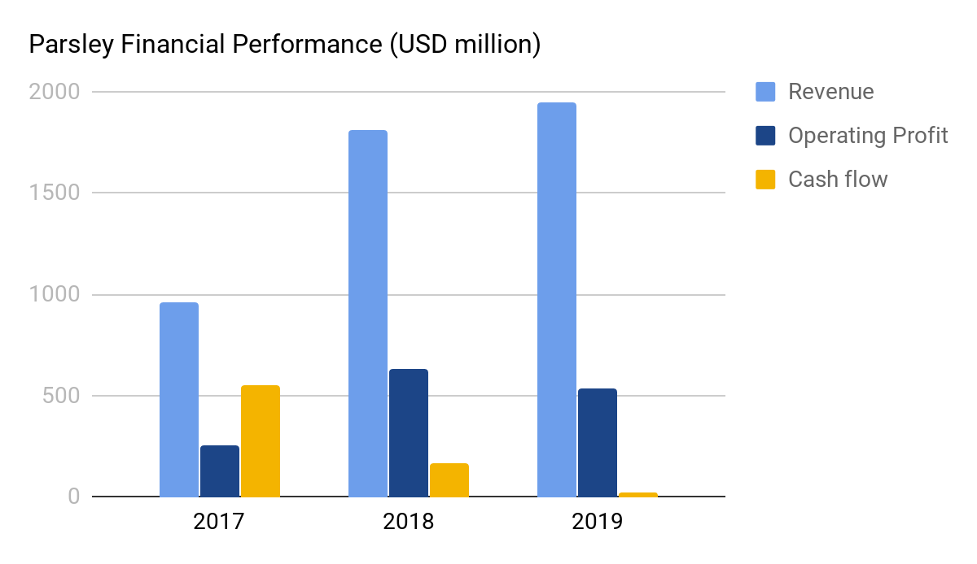
Background - Parsley
Parsley is a fast-growing pure-play upstream company
Overview
Financial performance
Established in 2008
Led by CEO Matt Gallagher
Upstream focused company
Operates mainly in Permian basin
Daily oil production: 140.6Mboe
NYSE Symbol: PE
Market Cap: $6,781MM
Net Debt: $3,032MM
Enterprise Value: $9,813MM
Share count: 413MM
Compared to stable revenue and operating profit, the cash position has been worsening

Slide 4
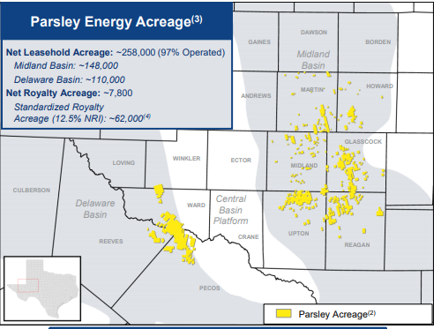
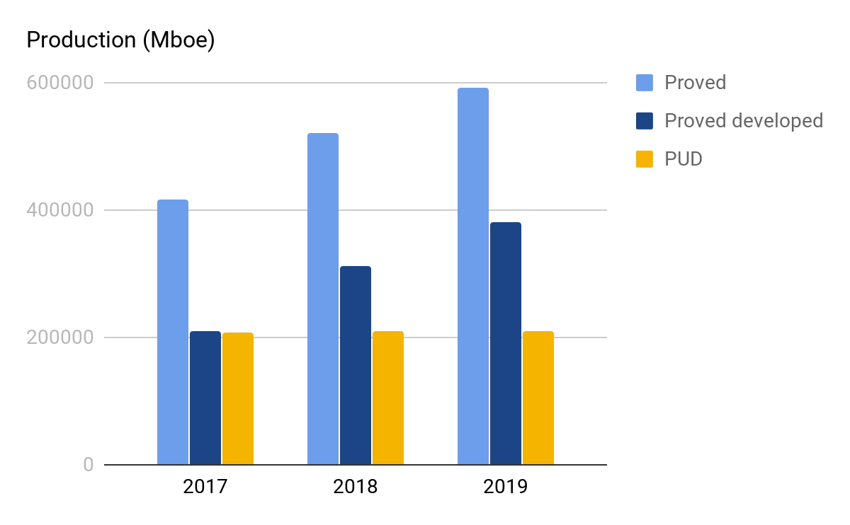
Background - Parsley
Parsley operates ~246K acreage with 592K Mboe proved reserve
Operation
Production & well operation
In 2019, Parsley operates ~240K acreage in Midland basin and Delaware basin
~85% of the wells, as well as production volumes, are from Midland basin
Avg. daily production
68
109
141

Slide 5
Table of content
Background - Parsley
Background - Jagged Peak
M&A Rationale & Transaction
Our Valuation
Verdict

Slide 6
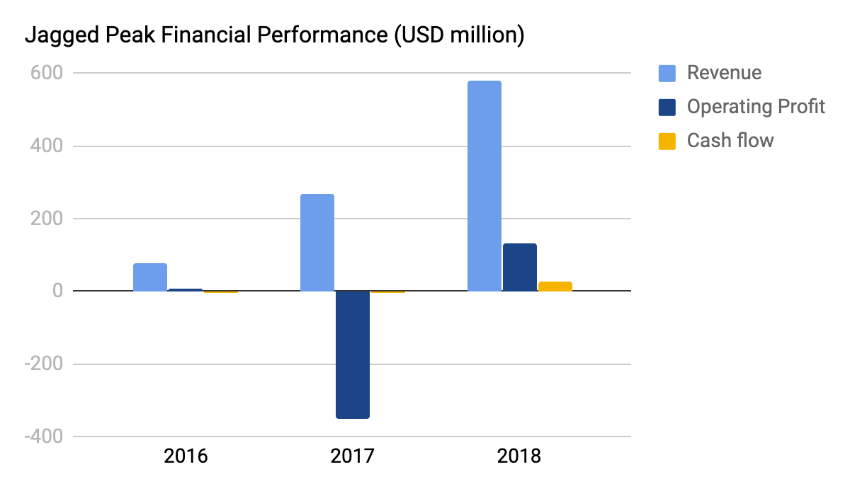
Background - Jagged Peak
Jagged Peak is a fast-growing upstream company with advanced tech
Overview
Financial performance*
Established in 2013
Led by CEO Joseph Jaggers→James J. Kleckner
Oil and natural gas company
Operates mainly in the Southern Delaware basin
Daily oil production: 38.4 Mboe
NYSE Symbol: JAG
Market Cap: $1,756MM
Net Debt: $744MM
Enterprise Value: $2500MM
Share count: 213.4MM
Achieved turnaround in 2018 by reducing DC&E costs
* JAG didn’t release its 2019 10K because of the merger
Notes:
https://finance.yahoo.com/quote/JAG/key-statistics/

Slide 7
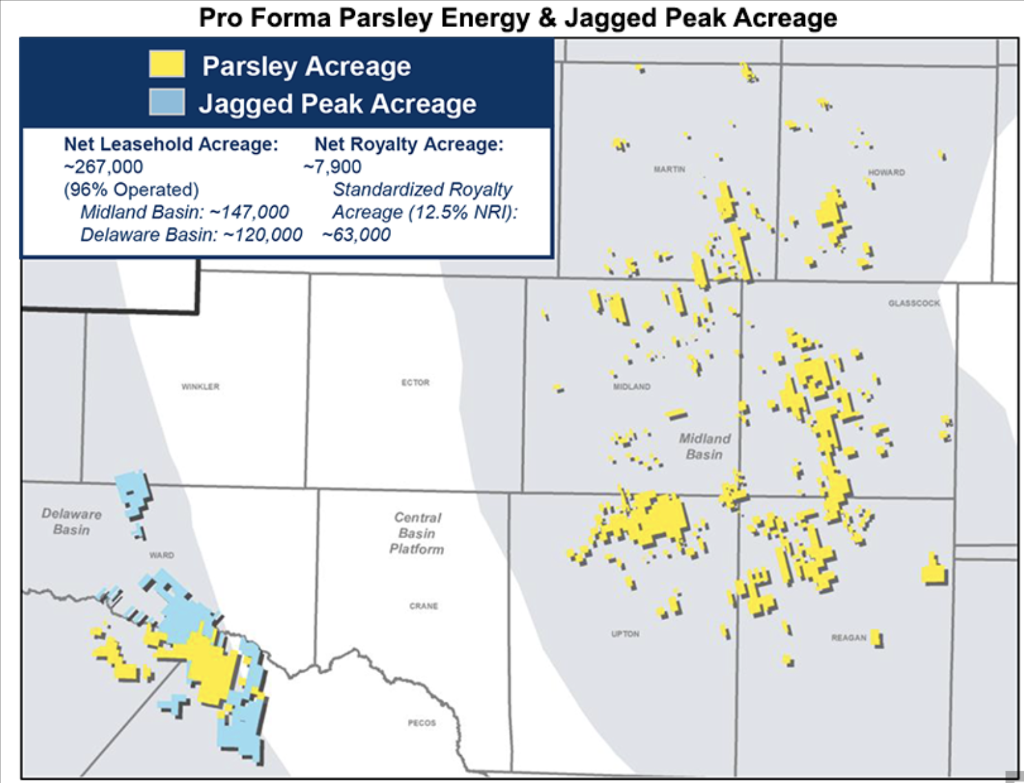
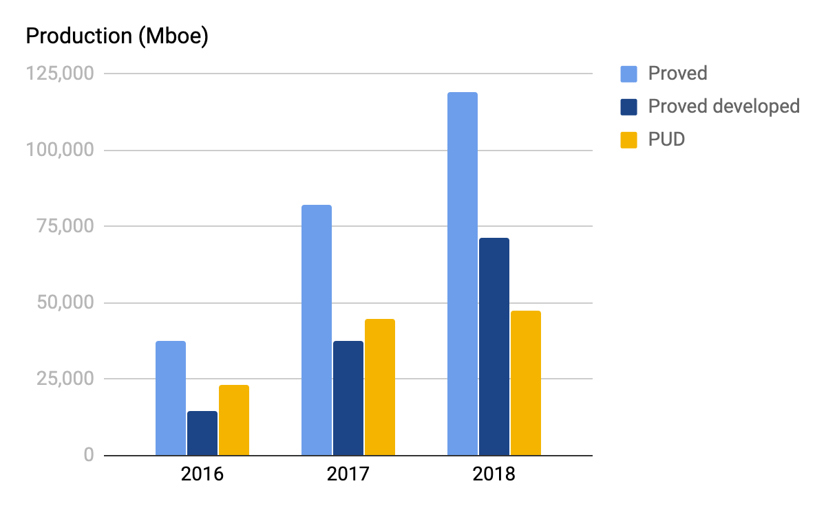
Background - Jagged Peak
Jagged Peak achieved solid production growth (above 15%)
Operation
Productions*
Currently operating 91,600 acres in the Southern Delaware Basin
JAG has increased its production efficiency by utilizing advanced tech such as 3D seismic
Avg. daily equivalent production
6
17
34
* JAG didn’t release its 2019 10K because of the merger
Notes:
During 2018, our average daily production of 34,207 Boe/d consisted of 77% oil, 12% NGLs and 11% natural gas.

Slide 8
Table of content
Background - Parsley
Background - Jagged Peak
M&A Rationale & Transaction
Our Valuation
Conclusion

Slide 9
M&A Rationale & Transaction
Parsley acquired JAG as it is a strategically aligned asset that could increase its cash flow in the future
Rationale:
Aligned with strategy, asset, and capabilities
Positive impact on Parsley’s cash flow
Details:
Parsley possesses an institutional familiarity with JAG's Delaware Basin assets
JAG's high-margin, oil-weighted asset base will integrate smoothly into Parsley's near-term development program
Also, JAG’s acreage footprint and water infrastructure dovetail into our legacy Delaware Basin position, and its corporate culture aligns with our core values.
With the assumption that West Texas Intermediate crude oil prices would average $50 per barrel in 2020, the combined company will generate huge FCF
The merger can solve the excessive CAPEX investment problem that Parsley is facing
Also, it is expected to generate cash G&A savings of approximately $25 million in the first year and $40-50 million of annual savings thereafter

Slide 10
M&A Rationale & Transaction
Parsley acquired JAG in an all-stock transaction valued at ~ $2.27B
Transaction
Rationale of all-stock transaction
Deal
All-stock transaction
With the all-stock transaction, Parsley wanted to maintain strong balance sheet
An all-stock transaction ensures the combined company will retain a strong balance sheet with a pro forma net leverage ratio of 1.6x LTM adjusted earnings before interest, income taxes, depreciation, depletion, amortization, and exploration expense
Parsley expects to maintain its dividend per share at current levels in the near term, with the anticipated free cash flow enhancements from this transaction expected to support ithe ncreased return of capital in the future
Value
Approximately $2.27 billion
Debt obligation
Parsley also acquired JAG’s net debt of ~$625 million
Transaction
JAG shareholders will receive 0.447 shares of Parsley‘s common stock
Premium
1.5% compared to JAG's 30-day volume weighted average*
* It is 11.2% compared to Jagged Peak's closing price on October 11, 2019.

Slide 11
Table of content
Background - Parsley
Background - Jagged Peak
M&A Rationale & Transaction
Our Valuation
Conclusion

Slide 12
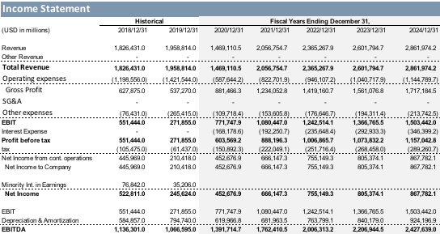
Revenue projection of PE
Parsley expected to grow in revenue 7.8% CAGR (5yrs)
Key assumptions
I/S projection
Production of Oil, Natural Gas, and NGL decreases due to COVID-19 in 2020 1H
PE do not have to borrow money with high interests' rate.( It is a potential risk)
The recovery of the price for 2020 2H
Operating expense as % of Rev.
Capex continues at a modest level
Revenue increases from $1.5B to $2.8B
NI increases to $865mm in 5 years

Slide 13
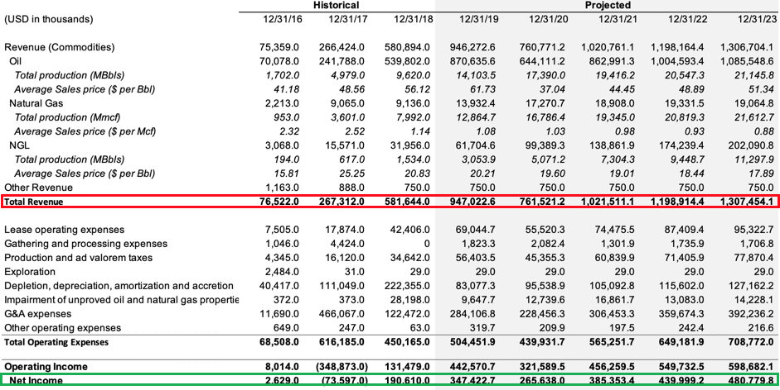
Revenue projection of JAG
JAG expected to grow in revenue 8.4% annually
Key assumptions
I/S projection
Production of Oil, Natural Gas, and NGL decreases due to depletion
Prices of the commodities move similar to historical data of the last 3 years
A plunging oil price in 2020 was accounted for the projection
The recovery of the price after 2020
Operating expense as % of Rev.
CapEx continues at modest level
Revenue increases from $947mm to $1.3B
NI increases to $480mm in 5 years

Slide 14
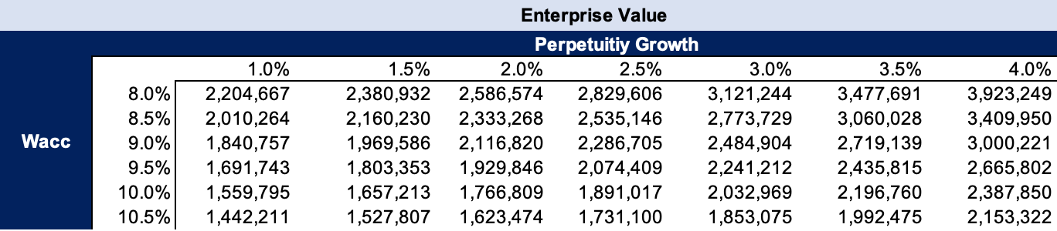
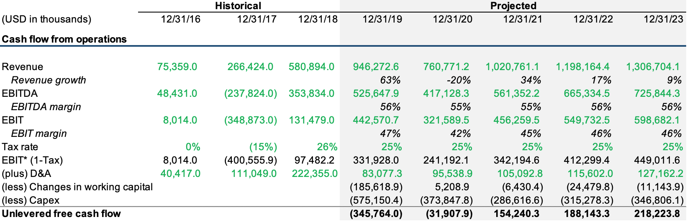
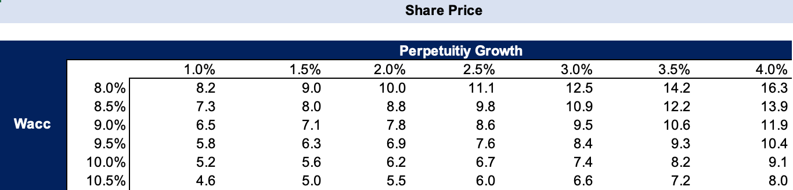
DCF valuation for JAG
EV of JAG from DCF valuation is ~$2.17B
The EV derived from DCF is similar to the offering price of PE
Application of recent plunging oil price due to R vs. S and COVID-19 into the model affected the value
Sensitizing to WACC and perpetuity growth rate, EV and Share price can vary

Slide 15
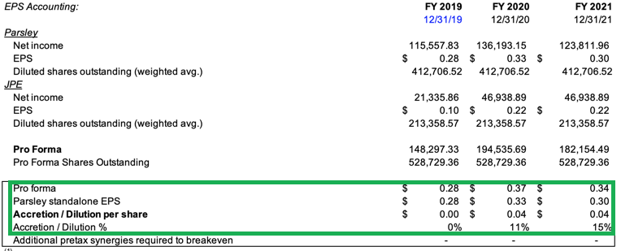
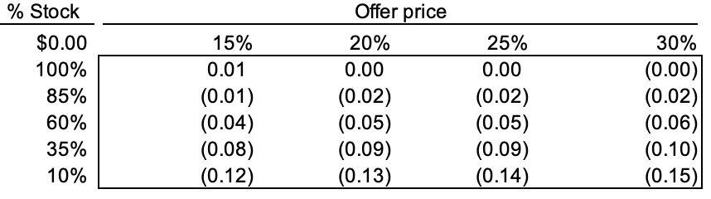
Accretion & Dilution Analysis for the transaction
The transaction is expected to accretive to Parsley
Accretion & Dilution analysis
The stock prices of the acquirer (PE) and the target (JPE) on 6/30/2019
PE - $18 / JPE - $8.27
Key Assumptions
All-stock deal
The target’s debt to be assumed
25% premium
25% of SG&A cost-cutting synergies
The change in deal-structure (cash involved) lowers the EPS due to interests to be additionally paid out
All-stock deal gives the optimal result
Sensitivity analysis

Slide 16
Table of content
Background - Parsley
Background - Jagged Peak
M&A Rationale & transaction
Our Valuation
Conclusion

Slide 17
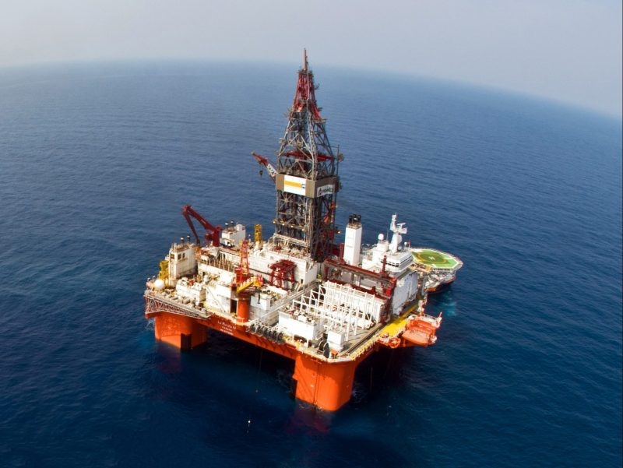


Conclusion
The M&A was a strategically sound decision with a fair price
Parsley and Jagged Peak M&A added to their respective hedge positions, and most of the combined company's expected oil production is subject to hedge protection.
An all-stock transaction ensures the combined company will retain a strong balance sheet to handle the unprecedented situation like the slump oil price.
Operational hedge
Financial hedge
More cash on hand

Slide 18

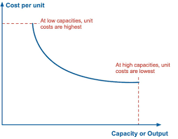
Conclusion
Our target price is $9.5 which has 23% upside
Further synergies over time, including reduced well costs, benefit from scale, capital allocation optionality, and peer-leading economics that will enhance the corporate free cash flow profile.
However, there is still systematic risks(low oil price) and political risk (financial aids).
Low cost
Economies of scale

Slide 19
Thank you

